Slide 3
Bible Reading
Philip Adams

Slide 4
John 2:12-25
12 After this he went down to Capernaum with his mother and brothers and his disciples. There they stayed for a few days. 13 When it was almost time for the Jewish Passover, Jesus went up to Jerusalem. 14 In the temple courts he found men selling cattle, sheep and doves, and others sitting at tables exchanging money.
New International Version

Slide 5
John 2:12-25
15 So he made a whip out of cords, and drove all from the temple area, both sheep and cattle; he scattered the coins of the money changers and overturned their tables. 16 To those who sold doves he said, "Get these out of here! How dare you turn my Father's house into a market!" 17 His disciples remembered that it is written: "Zeal for your house will consume me."
New International Version

Slide 6
John 2:12-25
18 Then the Jews demanded of him, "What miraculous sign can you show us to prove your authority to do all this?" 19 Jesus answered them, "Destroy this temple, and I will raise it again in three days." 20 The Jews replied, "It has taken forty-six years to build this temple, and you are going to raise it in three days?" 21 But the temple he had spoken of was his body.
New International Version

Slide 7
John 2:12-25
22 After he was raised from the dead, his disciples recalled what he had said. Then they believed the Scripture and the words that Jesus had spoken. 23 Now while he was in Jerusalem at the Passover Feast, many people saw the miraculous signs he was doing and believed in his name.
New International Version

Slide 8
John 2:12-25
24 But Jesus would not entrust himself to them, for he knew all men. 25 He did not need man's testimony about man, for he knew what was in a man.
New International Version

Slide 9
JESUS CHRIST
THE TEMPLE OF GOD
John 2:12-25

Slide 11
John 2:1-11

Slide 13
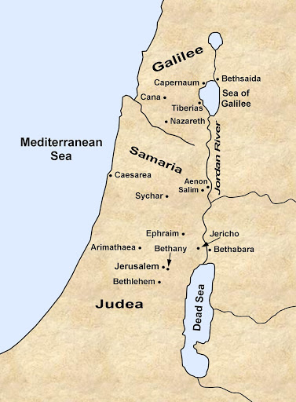

Slide 14
X
John 2:12-25
12 After this he went down to Capernaum with his mother and brothers and his disciples. There they stayed for a few days. 13 When it was almost time for the Jewish Passover, Jesus went up to Jerusalem. 14 In the temple courts he found men selling cattle, sheep and doves, and others sitting at tables exchanging money.
New International Version

Slide 15
Passover....
1st of the 3 occasions
14th of the first month yearly
Remembrance Day (Exodus 12)
God’s redemptive work for Israel
New Testament
Passover + Exodus
Christ’s redemptive work
Jesus – ‘Our Passover Lamb’ (1 Cor 5:7)
Jesus attended since childhood
1st time returned as Messiah

Slide 16
X
John 2:12-25
12 After this he went down to Capernaum with his mother and brothers and his disciples. There they stayed for a few days. 13 When it was almost time for the Jewish Passover, Jesus went up to Jerusalem. 14 In the temple courts he found men selling cattle, sheep and doves, and others sitting at tables exchanging money.
New International Version

Slide 18
X
John 2:12-25
15 So he made a whip out of cords, and drove all from the temple area, both sheep and cattle; he scattered the coins of the money changers and overturned their tables. 16 To those who sold doves he said, "Get these out of here! How dare you turn my Father's house into a market!" 17 His disciples remembered that it is written: "Zeal for your house will consume me."
New International Version

Slide 19
TWO accounts of
Jesus cleansed the Temple
Matthew 21, Mark 11 & Luke 19
2nd account
Final week of Jesus’ ministry
John 2
1st account
Beginning of Jesus’ ministry
Prophesy of the Messiah revealed
(Malachi 3:1-3)

Slide 20
John 2:12-25
18 Then the Jews demanded of him, "What miraculous sign can you show us to prove your authority to do all this?" 19 Jesus answered them, "Destroy this temple, and I will raise it again in three days." 20 The Jews replied, "It has taken forty-six years to build this temple, and you are going to raise it in three days?" 21 But the temple he had spoken of was his body.
New International Version

Slide 21
X
John 2:12-25
18 Then the Jews demanded of him, "What miraculous sign can you show us to prove your authority to do all this?" 19 Jesus answered them, "Destroy this temple, and I will raise it again in three days." 20 The Jews replied, "It has taken forty-six years to build this temple, and you are going to raise it in three days?" 21 But the temple he had spoken of was his body.
New International Version

Slide 22
Temple of Jerusalem ...
King Solomon - 959 BC built
- 586 BC destroyed by
Babylon
2. Zerubbabel - 519 BC rebuilt
- Lasted 500 years
- In a mess
3. Herod the Great - 19 BC reconstruct
- 46 years ongoing
- 70 AD destroyed

Slide 23
X
John 2:12-25
18 Then the Jews demanded of him, "What miraculous sign can you show us to prove your authority to do all this?" 19 Jesus answered them, "Destroy this temple, and I will raise it again in three days." 20 The Jews replied, "It has taken forty-six years to build this temple, and you are going to raise it in three days?" 21 But the temple he had spoken of was his body.
New International Version

Slide 24
Meaning of the Temple...
Heaven & Earth meets
Symbol of God’s divine grace &
loving-kindness
Jesus: ‘something greater’ (Matt 12:6-7)
God’s compassion
God’s favour
X

Slide 25
Jesus Christ …
Death: Heaven & Earth meets
The reality which the Temple points to
‘full of grace full of truth’ (John 1:14)
Not oppose the Temple
Save the Temple
Cleansed for the unreached

Slide 26
John 2:12-25
22 After he was raised from the dead, his disciples recalled what he had said. Then they believed the Scripture and the words that Jesus had spoken.
New International Version

Slide 27
X
John 2:12-25
23 Now while he was in Jerusalem at the Passover Feast, many people saw the miraculous signs he was doing and believed in his name. 24 But Jesus would not entrust himself to them, for he knew all men. 25 He did not need man's testimony about man, for he knew what was in a man.
New International Version

Slide 28
Lesson:
Temple
God’s Compassion
Divine grace
Loving-kindness
For all nations
Ultimate Temple
Person of Jesus Christ
Lives of Disciples
It is God’s favour

