Slide 1
Bible Reading
Myra Parker

Slide 2
John 3:31-36
31 "The one who comes from above is above all; the one who is from the earth belongs to the earth, and speaks as one from the earth. The one who comes from heaven is above all. 32 He testifies to what he has seen and heard, but no one accepts his testimony. 33 The man who has accepted it has certified that God is truthful.
New International Version

Slide 3
John 3:31-36
34 For the one whom God has sent speaks the words of God, for God gives the Spirit without limit. 35 The Father loves the Son and has placed everything in his hands. 36 Whoever believes in the Son has eternal life, but whoever rejects the Son will not see life, for God's wrath remains on him."
New International Version

Slide 5
X
Born Again…
3:01-21: Jesus & Nicodemus
(v1-20) Born Again
(v21) The Outcome
“lives by the truth and comes to the light.” – God’s work reveals.
3:22-36: John the Baptist
(v22-30) Joy to serve Jesus (HE > i)
(v31-36) Exalt Jesus (HE > all)

Slide 6
X
Born Again…
How would I know?
Capacity to live by Jesus
and come to Jesus
Joy in Jesus
Exalt Jesus

Slide 7
5 Factors about Jesus
Divine Origin (v31)
Divine Revelation (32)
Divine God (v33)
Divine Fellowship (v34)
Divine Authority (v35)

Slide 8
John 3:31-36
31 "The one who comes from above is above all; the one who is from the earth belongs to the earth, and speaks as one from the earth. The one who comes from heaven is above all. 32 He testifies to what he has seen and heard, but no one accepts his testimony. 33 The man who has accepted it has certified that God is truthful.
New International Version

Slide 9
X
John 3:31-36
31 "The one who comes from above is above all; the one who is from the earth belongs to the earth, and speaks as one from the earth. The one who comes from heaven is above all. 32 He testifies to what he has seen and heard, but no one accepts his testimony. 33 The man who has accepted it has certified that God is truthful.
New International Version

Slide 11
X
John 3:31-36
31 "The one who comes from above is above all; the one who is from the earth belongs to the earth, and speaks as one from the earth. The one who comes from heaven is above all. 32 He testifies to what he has seen and heard, but no one accepts his testimony. 33 The man who has accepted it has certified that God is truthful.
New International Version

Slide 13
X
John 3:31-36
31 "The one who comes from above is above all; the one who is from the earth belongs to the earth, and speaks as one from the earth. The one who comes from heaven is above all. 32 He testifies to what he has seen and heard, but no one accepts his testimony. 33 The man who has accepted it has certified that God is truthful.
New International Version

Slide 14
This is my Son, whom I love; with Him I am well pleased.
~ Matthew 3:17
This is my Son, whom I have chosen; listen to Him.
~ Luke 9:35

Slide 15
X
John 3:31-36
34 For the one whom God has sent speaks the words of God, for God gives the Spirit without limit. 35 The Father loves the Son and has placed everything in his hands. 36 Whoever believes in the Son has eternal life, but whoever rejects the Son will not see life, for God's wrath remains on him."
New International Version

Slide 16
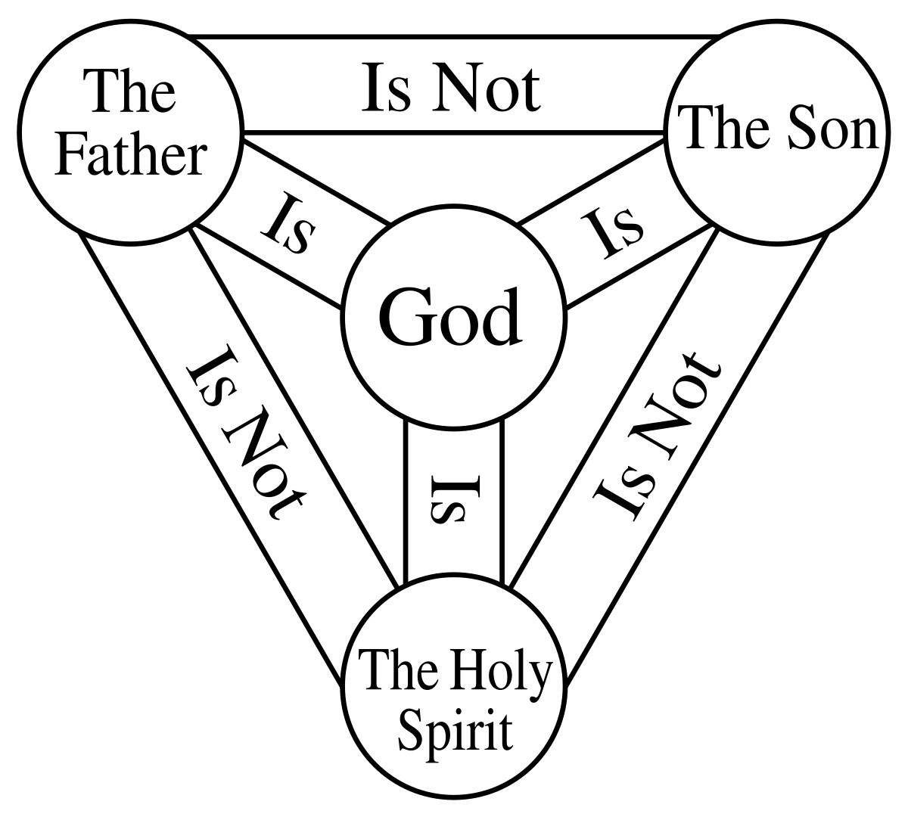
X
Equal in the fullness of :
Power
Sovereignty
Holiness

Slide 18
X
John 3:31-36
34 For the one whom God has sent speaks the words of God, for God gives the Spirit without limit. 35 The Father loves the Son and has placed everything in his hands. 36 Whoever believes in the Son has eternal life, but whoever rejects the Son will not see life, for God's wrath remains on him."
New International Version

Slide 19
X

Slide 20
X
Application:
Humble before Jesus
Believe Jesus
Let Jesus take Lordship ~
Don’t take yourself too seriously!

Slide 21
X

Slide 22
John 3:31-36
34 For the one whom God has sent speaks the words of God, for God gives the Spirit without limit. 35 The Father loves the Son and has placed everything in his hands. 36 Whoever believes in the Son has eternal life, but whoever rejects the Son will not see life, for God's wrath remains on him."
New International Version

