Slide 1

Bible Reading
Judy Batrouney

Slide 2
John 4:16-26
16 He told her, "Go, call your husband and come back." 17 "I have no husband," she replied. 18 Jesus said to her, "You are right when you say you have no husband. The fact is, you have had five husbands, and the man you now have is not your husband. What you have just said is quite true." 19 "Sir," the woman said, "I can see that you are a prophet.
New International Version

Slide 3
John 4:16-26
20 Our fathers worshiped on this mountain, but you Jews claim that the place where we must worship is in Jerusalem." 21 Jesus declared, "Believe me, woman, a time is coming when you will worship the Father neither on this mountain nor in Jerusalem. 22 You Samaritans worship what you do not know; we worship what we do know, for salvation is from the Jews.
New International Version

Slide 4
John 4:16-26
23 Yet a time is coming and has now come when the true worshipers will worship the Father in spirit and truth, for they are the kind of worshipers the Father seeks. 24 God is spirit, and his worshipers must worship in spirit and in truth." 25 The woman said, "I know that Messiah" (called Christ) "is coming. When he comes, he will explain everything to us." 26 Then Jesus declared, "I who speak to you am he."
New International Version

Slide 5

Give Me
A Drink
Part TWO
John 4:16-26

Slide 6
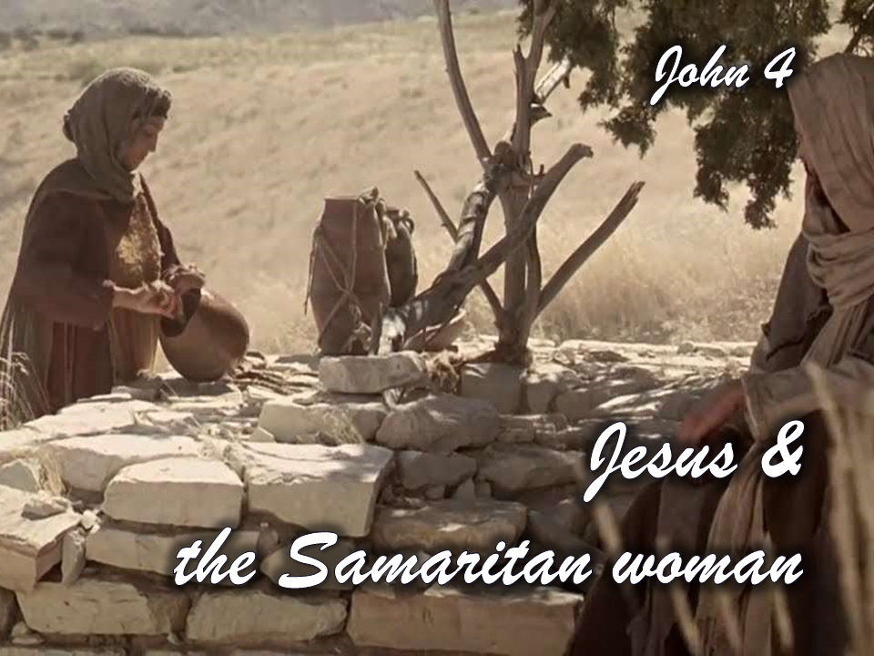

Slide 7

WHERE CAN I GET THIS?
John 4:15

Slide 8
John 4:16-26
15 …Give me this drink…
16 He told her, "Go, call your husband and come back." 17 "I have no husband," she replied. 18 Jesus said to her, "You are right when you say you have no husband. The fact is, you have had five husbands, and the man you now have is not your husband. What you have just said is quite true." 19 "Sir," the woman said, "I can see that you are a prophet.
New International Version

Slide 9
John 4:16-26
15 …Give me this drink…
16 He told her, "Go, call your husband and come back." 17 "I have no husband," she replied. 18 Jesus said to her, "You are right when you say you have no husband. The fact is, you have had five husbands, and the man you now have is not your husband. What you have just said is quite true." 19 "Sir," the woman said, "I can see that you are a prophet.
New International Version

Slide 10
John 4:16-26
15 …Give me this drink…
16 He told her, "Go, call your husband and come back." 17 "I have no husband," she replied. 18 Jesus said to her, "You are right when you say you have no husband. The fact is, you have had five husbands, and the man you now have is not your husband. What you have just said is quite true." 19 "Sir," the woman said, "I can see that you are a prophet.
New International Version

Slide 11
John 4:16-26
20 Our fathers worshiped on this mountain, but you Jews claim that the place where we must worship is in Jerusalem." 21 Jesus declared, "Believe me, woman, a time is coming when you will worship the Father neither on this mountain nor in Jerusalem. 22 You Samaritans worship what you do not know; we worship what we do know, for salvation is from the Jews.
New International Version

Slide 12
John 4:16-26
20 Our fathers worshiped on this mountain, but you Jews claim that the place where we must worship is in Jerusalem." 21 Jesus declared, "Believe me, woman, a time is coming when you will worship the Father neither on this mountain nor in Jerusalem. 22 You Samaritans worship what you do not know; we worship what we do know, for salvation is from the Jews.
New International Version

Slide 13
John 4:16-26
20 Our fathers worshiped on this mountain, but you Jews claim that the place where we must worship is in Jerusalem." 21 Jesus declared, "Believe me, woman, a time is coming when you will worship the Father neither on this mountain nor in Jerusalem. 22 You Samaritans worship what you do not know; we worship what we do know, for salvation is from the Jews.
New International Version

Slide 14
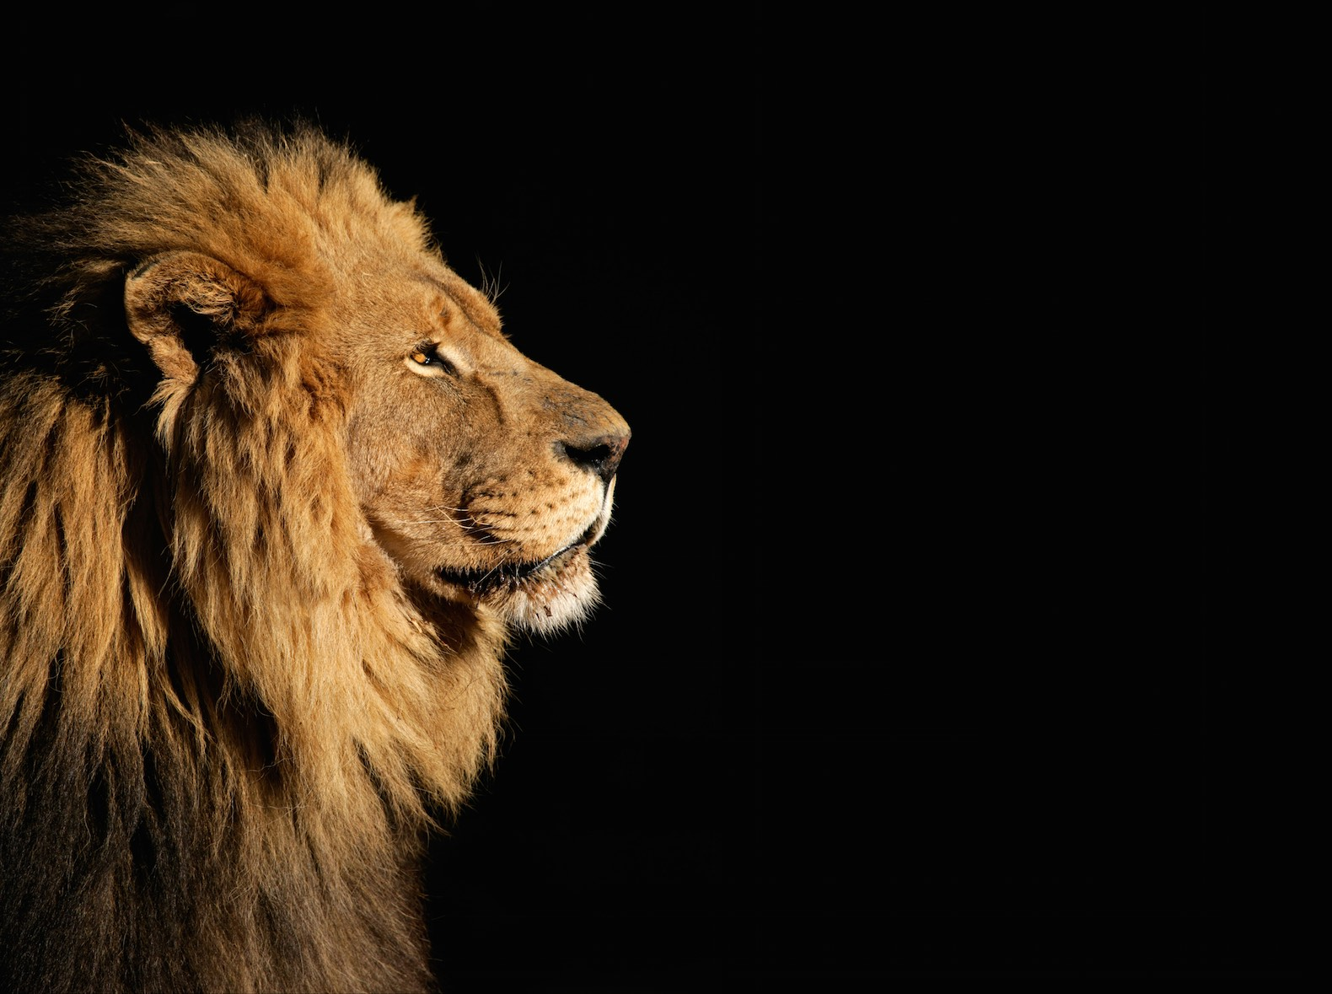
Revelation 5:5
Do not weep!
See, the Lion of
the tribe of Judah,
the Root of David,
has triumphed

Slide 15
John 4:16-26
23 Yet a time is coming and has now come when the true worshipers will worship the Father in spirit and truth, for they are the kind of worshipers the Father seeks. 24 God is spirit, and his worshipers must worship in spirit and in truth." 25 The woman said, "I know that Messiah" (called Christ) "is coming. When he comes, he will explain everything to us." 26 Then Jesus declared, "I who speak to you am he."
New International Version

Slide 16
John 4:16-26
23 Yet a time is coming and has now come when the true worshipers will worship the Father in spirit and truth, for they are the kind of worshipers the Father seeks. 24 God is spirit, and his worshipers must worship in spirit and in truth." 25 The woman said, "I know that Messiah" (called Christ) "is coming. When he comes, he will explain everything to us." 26 Then Jesus declared, "I who speak to you am he."
New International Version

Slide 17
John 4:16-26
23 Yet a time is coming and has now come when the true worshipers will worship the Father in spirit and truth, for they are the kind of worshipers the Father seeks. 24 God is spirit, and his worshipers must worship in spirit and in truth." 25 The woman said, "I know that Messiah" (called Christ) "is coming. When he comes, he will explain everything to us." 26 Then Jesus declared, "I who speak to you am he."
New International Version

Slide 18
John 4:16-26
23 Yet a time is coming and has now come when the true worshipers will worship the Father in spirit and truth, for they are the kind of worshipers the Father seeks. 24 God is spirit, and his worshipers must worship in spirit and in truth." 25 The woman said, "I know that Messiah" (called Christ) "is coming. When he comes, he will explain everything to us." 26 Then Jesus declared, "I who speak to you am he."
New International Version

Slide 19
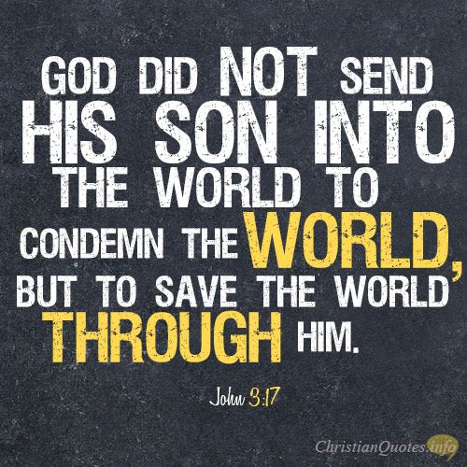

Slide 20

Jesus
Know
Seek
Redeem

