Slide 1
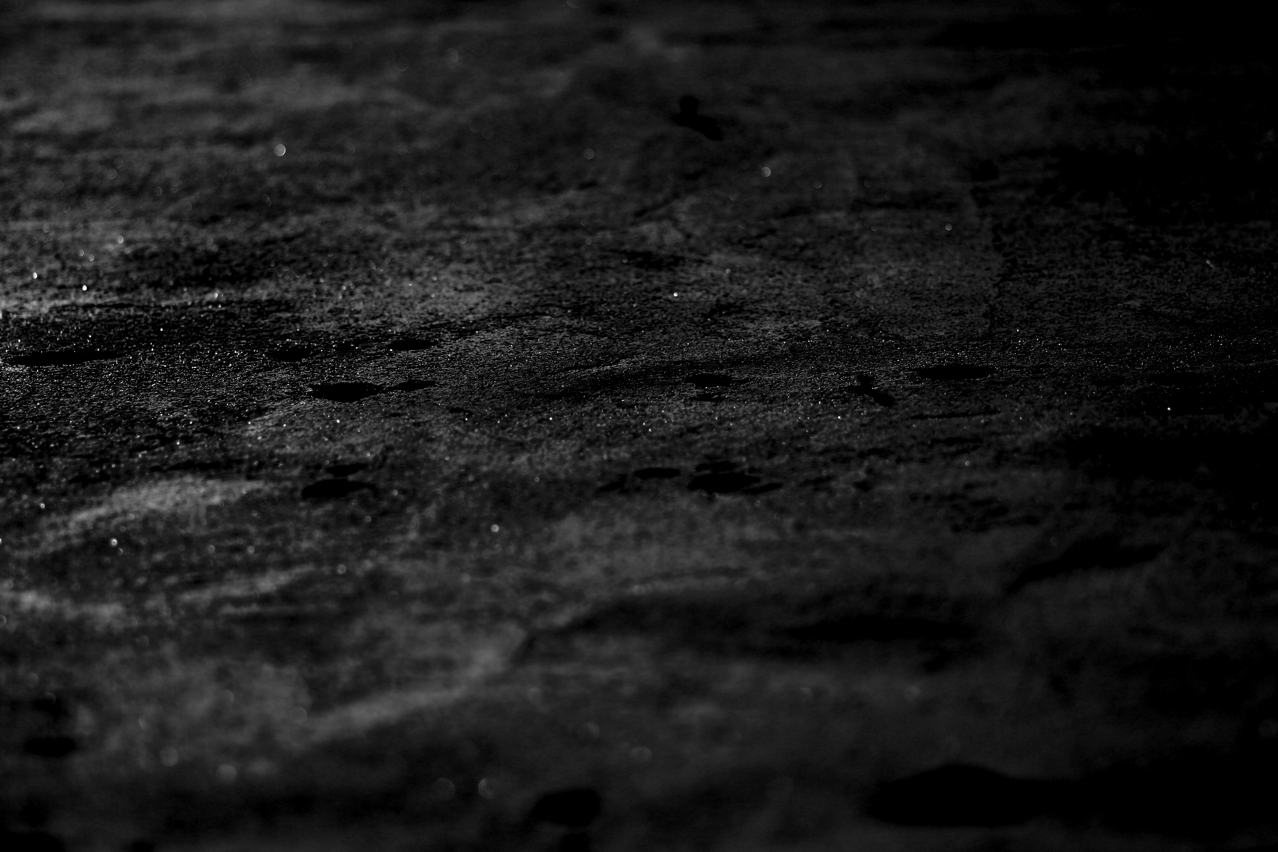
Bible Reading
Lois Yen

Slide 2
John 5:30-40
30 By myself I can do nothing; I judge only as I hear, and my judgment is just, for I seek not to please myself but him who sent me. 31 "If I testify about myself, my testimony is not valid. 32 There is another who testifies in my favour, and I know that his testimony about me is valid. 33 "You have sent to John and he has testified to the truth. 34 Not that I accept human testimony; but I mention it that you may be saved.
New International Version

Slide 3
John 5:30-40
35 John was a lamp that burned and gave light, and you chose for a time to enjoy his light. 36 "I have testimony weightier than that of John. For the very work that the Father has given me to finish, and which I am doing, testifies that the Father has sent me.
New International Version

Slide 4
John 5:30-40
37 And the Father who sent me has himself testified concerning me. You have never heard his voice nor seen his form, 38 nor does his word dwell in you, for you do not believe the one he sent. 39 You diligently study the Scriptures because you think that by them you possess eternal life. These are the Scriptures that testify about me, 40 yet you refuse to come to me to have life.
New International Version

Slide 5


Slide 6
John’s Gospel Chapter 5:
Healed a man by Bethesda pool (v1-18)
    Sinful world: disbelieve & distrust
Claimed to be equal to God (v19-29)
    Instrument to save the world
    Power, authority, honour and truth
Powerful witnesses (v30-40)
    Backup Jesus’ claim
Barriers to believe (v41-47)
    Consequence to disbelieve

Slide 7
John’s Gospel Chapter 5:
Uplifting :- Declared Jesus’ deity
Sad :- Jesus’ persecution begins

Slide 8
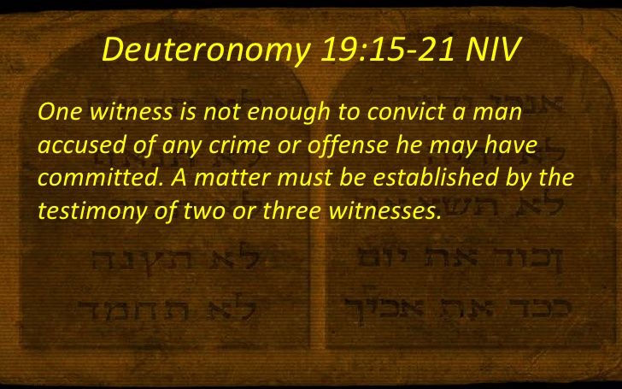

Slide 9

Powerful Witnesses to
JESUS claims….
The Father
John the Baptist
The Work of Jesus
The Scriptures

Slide 10
John 5:30-40
30 By myself I can do nothing; I judge only as I hear, and my judgment is just, for I seek not to please myself but him who sent me. 31 "If I testify about myself, my testimony is not valid.
… … …
37 And the Father who sent me has himself testified concerning me. You have never heard his voice nor seen his form, 38 nor does his word dwell in you, for you do not believe the one he sent.
New International Version

Slide 11

I call the heavens and the earth
as witnesses
against you this day that you will quickly perish from the land that you are crossing the Jordan to possess. You will not live there long but will certainly be destroyed.
Deuteronomy 4 26

Slide 12
John 5:30-40
32 There is another who testifies in my favour, and I know that his testimony about me is valid. 33 "You have sent to John and he has testified to the truth. 34 Not that I accept human testimony; but I mention it that you may be saved. 35 John was a lamp that burned and gave light, and you chose for a time to enjoy his light.
New International Version

Slide 13
John The Baptist
1 | Sent by God to testify the true Light (John 1:6-8)
2 | Way maker. Prepare people for the coming Messiah. “Look, the Lamb of God, who takes away the sin of the world!” (John 1:29)
3 | Baptised Jesus, witnessed Holy Spirit rested on Jesus, and heard God said: (Mark 3:17) “This is my Son, whom I love, with Him I am well pleased.”
4 | The Greatest man who ever lived. (Matthew 11:11)
5 | Last OT prophet & First NT preacher.
6 | Priestly heritage - son of Zechariah. (Luke 1:5-25, 57-76)

Slide 14
John 5:30-40
36 "I have testimony weightier than that of John. For the very work that the Father has given me to finish, and which I am doing, testifies that the Father has sent me. 37 And the Father who sent me has himself testified concerning me. You have never heard his voice nor seen his form, 38 nor does his word dwell in you, for you do not believe the one he sent.
New International Version

Slide 15
Signs & Wonders:
Chap 2: Water into wine
Chap 2: Cleanse the Temple
Chap 4: Woman by the Well
Chap 4: Healing of an official son
Chap 5: Healing of a man by the pool

Slide 16
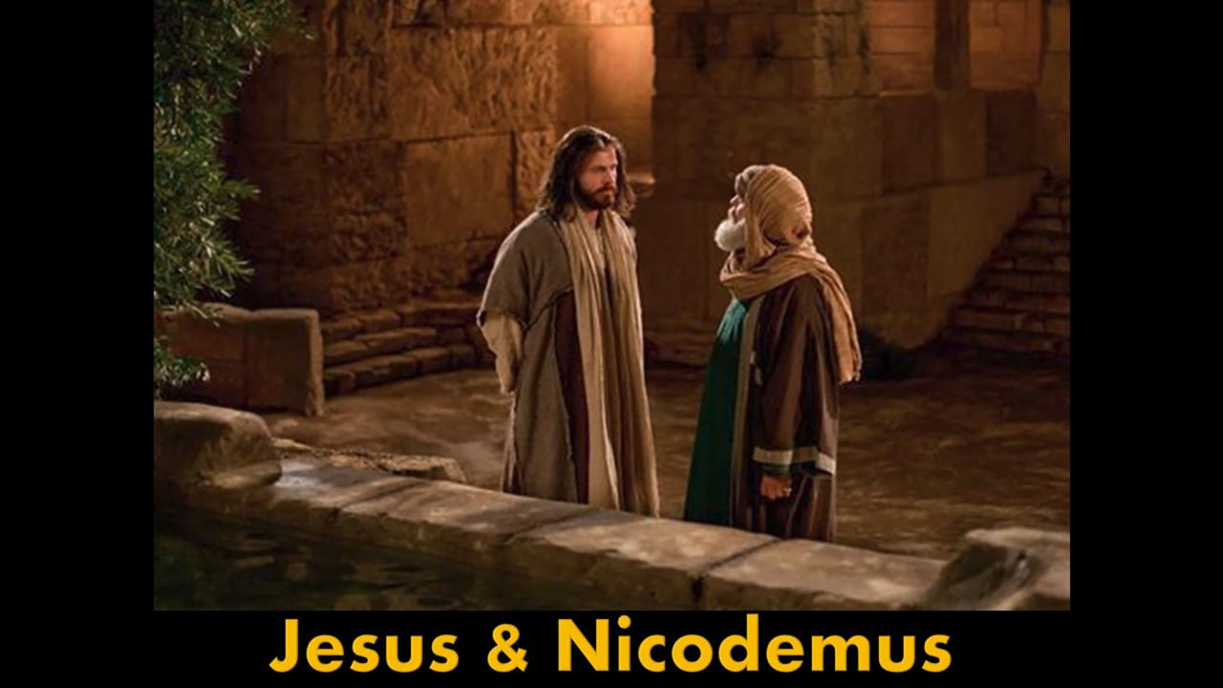
John 3:1-21
Rabbi…
we know you are a teacher who has come from God. For no one could perform the miraculous signs you are doing if God were not with him. (v2)

Slide 17
John 5:30-40
39 You diligently study the Scriptures because you think that by them you possess eternal life. These are the Scriptures that testify about me, 40 yet you refuse to come to me to have life.
New International Version

Slide 18
Superficial reasons to read the Bible:
A Fridge: Look for goodies
A Crystal ball: Look into future
A Law book or Life manual: Check boxes to live a righteous life

Slide 19

We have a BIBLE because
God has a MISSION

Slide 20
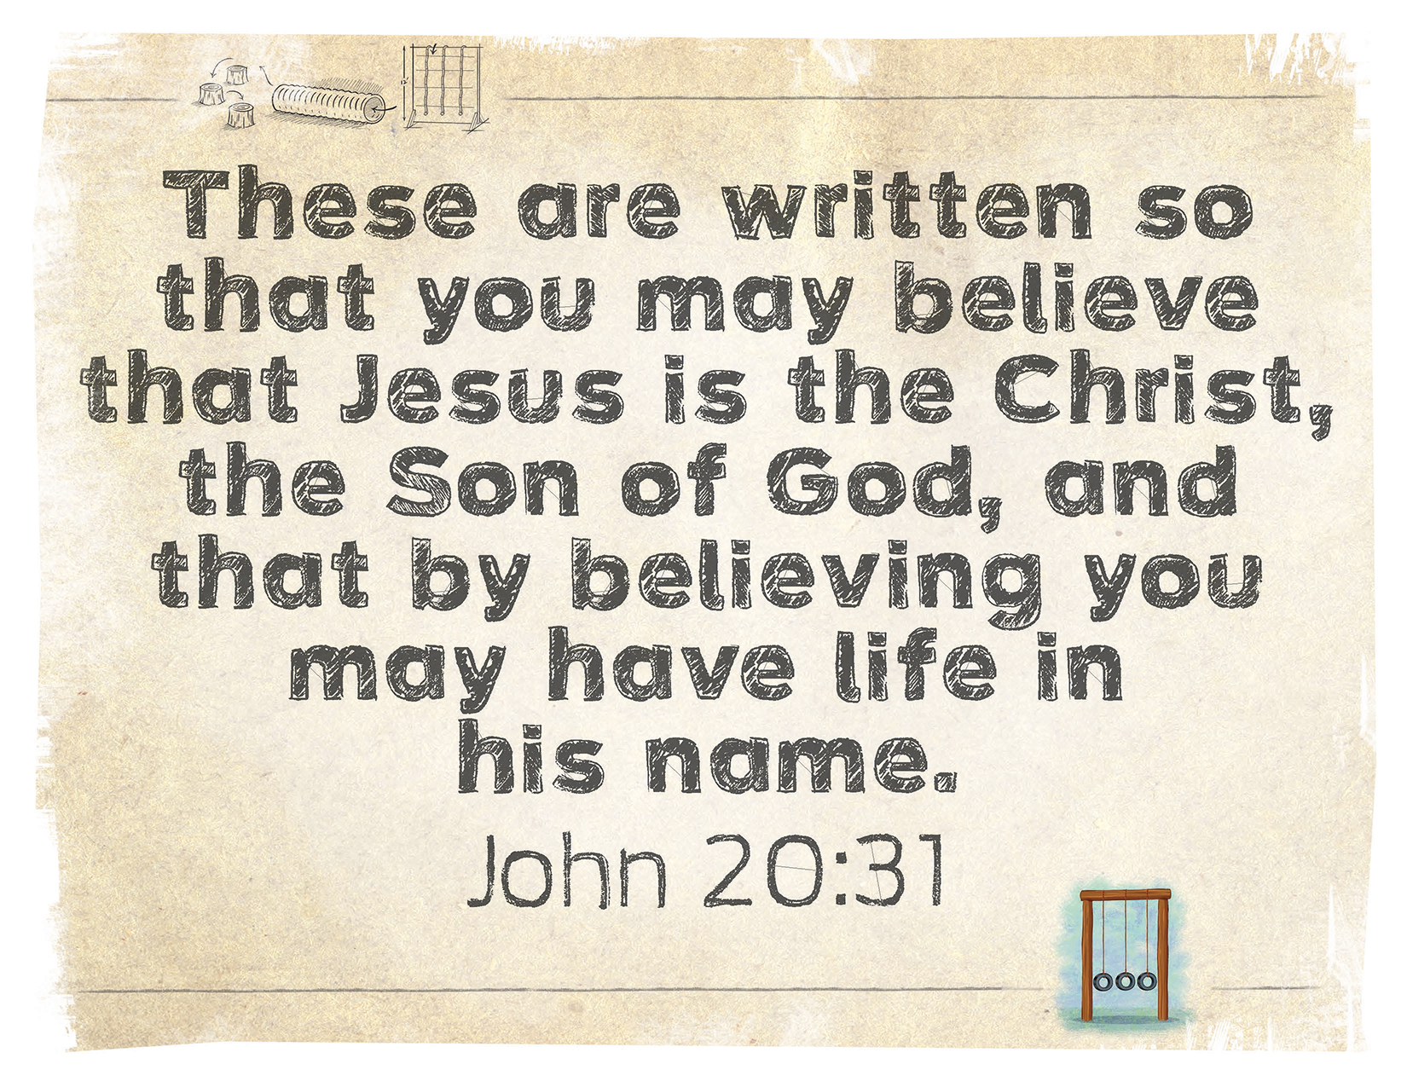

Slide 21
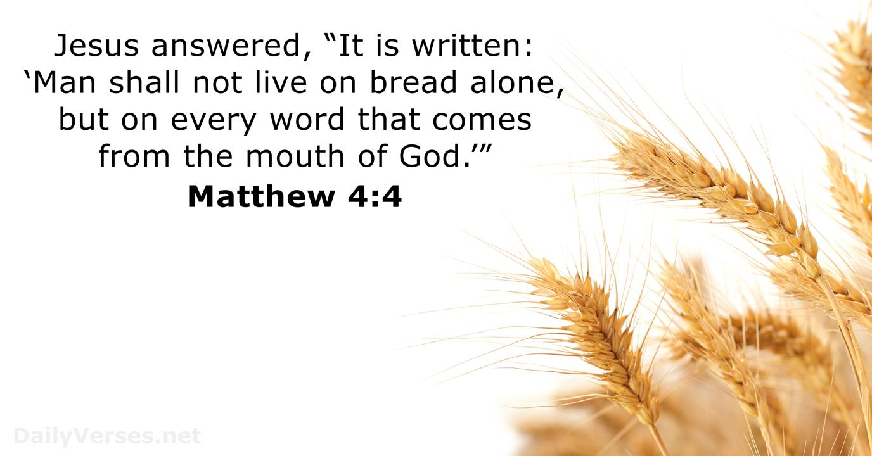

Slide 22
Powerful Witnesses to
Our identity…
Bible : Word became Flesh (John1:14)
Work: Holy Spirit convicts & reveals
  (John 16:8)
Man : Great cloud of witnesses
  (Hebrews 12:1)
God : Holy Spirit testifies we are God’s
children (Romans 8:14-17)

