Slide 1

Bible Reading
Jeremy Graham

Slide 2
Proverbs 31:10-31
10 A wife of noble character who can find? She is worth far more than rubies. 11 Her husband has full confidence in her and lacks nothing of value. 12 She brings him good, not harm, all the days of her life. 13 She selects wool and flax and works with eager hands. 14 She is like the merchant ships, bringing her food from afar. 15 She gets up while it is still dark; she provides food for her family and portions for her servant girls.
New International Version

Slide 3
Proverbs 31:10-31
16 She considers a field and buys it; out of her earnings she plants a vineyard. 17 She sets about her work vigorously; her arms are strong for her tasks. 18 She sees that her trading is profitable, and her lamp does not go out at night. 19 In her hand she holds the distaff and grasps the spindle with her fingers. 20 She opens her arms to the poor and extends her hands to the needy. 21 When it snows, she has no fear for her household; for all of them are clothed in scarlet.
New International Version

Slide 4
Proverbs 31:10-31
22 She makes coverings for her bed; she is clothed in fine linen and purple. 23 Her husband is respected at the city gate, where he takes his seat among the elders of the land. 24 She makes linen garments and sells them, and supplies the merchants with sashes. 25 She is clothed with strength and dignity; she can laugh at the days to come. 26 She speaks with wisdom, and faithful instruction is on her tongue.
New International Version

Slide 5
Proverbs 31:10-31
27 She watches over the affairs of her household and does not eat the bread of idleness. 28 Her children arise and call her blessed; her husband also, and he praises her: 29 "Many women do noble things, but you surpass them all." 30 Charm is deceptive, and beauty is fleeting; but a woman who fears the Lord is to be praised. 31 Give her the reward she has earned, and let her works bring her praise at the city gate.
New International Version

Slide 6
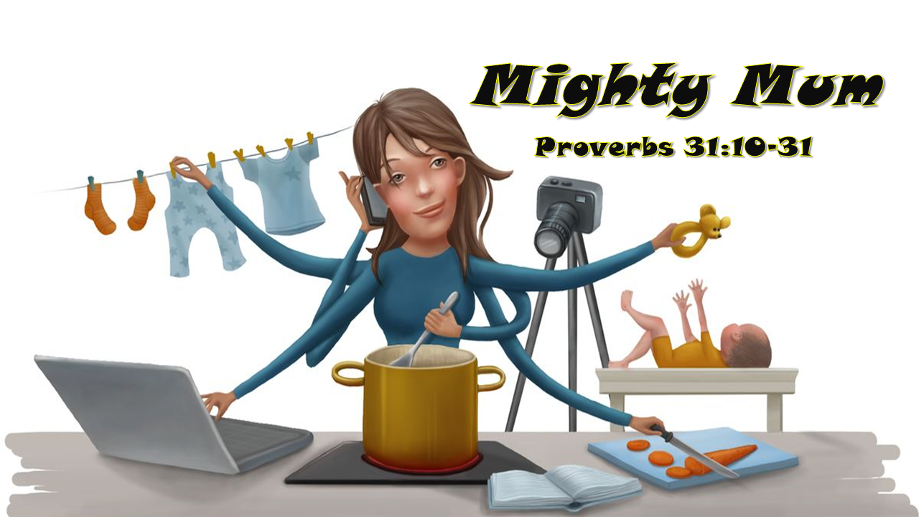
Jimmy Yen
09/05/2021

Slide 7

Wisdom
Literature in the Bible
Proverbs
Ecclesiastes
Job

Slide 8
Wisdom
Literature in the Bible
What kind of world do we living in?
What does it look like to live well in this world?

Slide 9
The Book of Proverbs
  A brilliant young woman teacher
  Smart
  Incredible insights
  Believes an invisible force (wisdom)

Slide 10
The Book of Proverbs
  A brilliant young woman teacher
  Smart
  Incredible insights
  Believes an invisible force (wisdom)
  Wisdom is more than knowledge
      Attribute of God
      Good vs Bad decisions

Slide 11
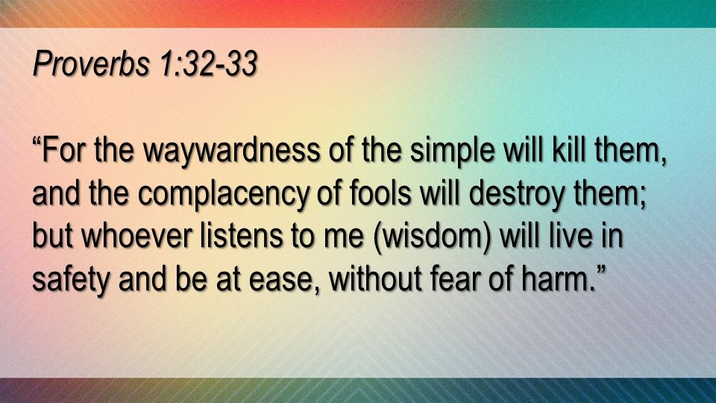
Moral Law of the universe

Slide 12
The Book of Proverbs
  A brilliant young woman teacher
  Smart
  Incredible insights
  Believes an invisible force (wisdom)
  Wisdom is more than knowledge
      Attribute of God
      Good vs Bad decisions
      Calling out and available to anyone who is willing to listen and learn

Slide 13
The Book of Proverbs
  Wisdom is more than knowledge
      Attribute of God
      Good vs Bad decisions
      Calling out and available to anyone who is willing to listen and learn
      NOT Law or Prophecy or Promises or Formulas to success

Slide 14
The Book of Proverbs
  Wisdom is more than knowledge
      Attribute of God
      Good vs Bad decisions
      Calling out and available to anyone who is willing to listen and learn
      NOT Law or Prophecy or Promises or Formulas to success
      ONLY probabilities of good life
      Focuses on general rule of life not exceptions.

Slide 15
Mighty Mum
A Woman of Noble Character
Proverbs 31:10-31
Lives according to wisdom of Proverbs
Stands like a model
of someone who takes God’s wisdom
and puts into practice in everyday decisions making.
(i.e. home, work, family & community)

Slide 16
Proverbs 31:10-31
27 She watches over the affairs of her household and does not eat the bread of idleness. 28 Her children arise and call her blessed; her husband also, and he praises her: 29 "Many women do noble things, but you surpass them all." 30 Charm is deceptive, and beauty is fleeting; but a woman who fears the Lord is to be praised. 31 Give her the reward she has earned, and let her works bring her praise at the city gate.
New International Version

Slide 17
1. Fear the Lord
  The beginning of wisdom (Pr 9:10)
  Not terror
  Healthy sense of respect for God and my place in the universe
  Moral mindset – “I am not God”
      True wisdom – Do not cross God’s line
      Helps to find a path toward success

Slide 18
Proverbs 31:10-31
13 She selects wool and flax and works with eager hands. 14 She is like the merchant ships, bringing her food from afar. 15 She gets up while it is still dark; she provides food for her family and portions for her servant girls. 16 She considers a field and buys it; out of her earnings she plants a vineyard. 17 She sets about her work vigorously; her arms are strong for her tasks. 18 She sees that her trading is profitable, and her lamp does not go out at night. 19 In her hand she holds the distaff and grasps the spindle with her fingers.
New International Version
Diligent

Slide 19
Proverbs 31:10-31
16 She considers a field and buys it; out of her earnings she plants a vineyard. 17 She sets about her work vigorously; her arms are strong for her tasks. 18 She sees that her trading is profitable, and her lamp does not go out at night. 19 In her hand she holds the distaff and grasps the spindle with her fingers. 20 She opens her arms to the poor and extends her hands to the needy. 21 When it snows, she has no fear for her household; for all of them are clothed in scarlet.
New International Version
Loving

Slide 20


Slide 21
Proverbs 31:10-31
23 Her husband is respected at the city gate, where he takes his seat among the elders of the land. 24 She makes linen garments and sells them, and supplies the merchants with sashes. 25 She is clothed with strength and dignity; she can laugh at the days to come. 26 She speaks with wisdom, and faithful instruction is on her tongue. 27 She watches over the affairs of her household and does not eat the bread of idleness.
New International Version
Wise

Slide 22
Proverbs 31:10-31
27 She watches over the affairs of her household and does not eat the bread of idleness. 28 Her children arise and call her blessed; her husband also, and he praises her: 29 "Many women do noble things, but you surpass them all." 30 Charm is deceptive, and beauty is fleeting; but a woman who fears the Lord is to be praised. 31 Give her the reward she has earned, and let her works bring her praise at the city gate.
New International Version
Godliness

Slide 23
Mighty Mum
A Woman of Noble Character
Proverbs 31:10-31
Fear the Lord (v30b)
Diligent (v13-19)
Loving (v20)
Wise (v21-27)
Godliness (v30a)

