Slide 1
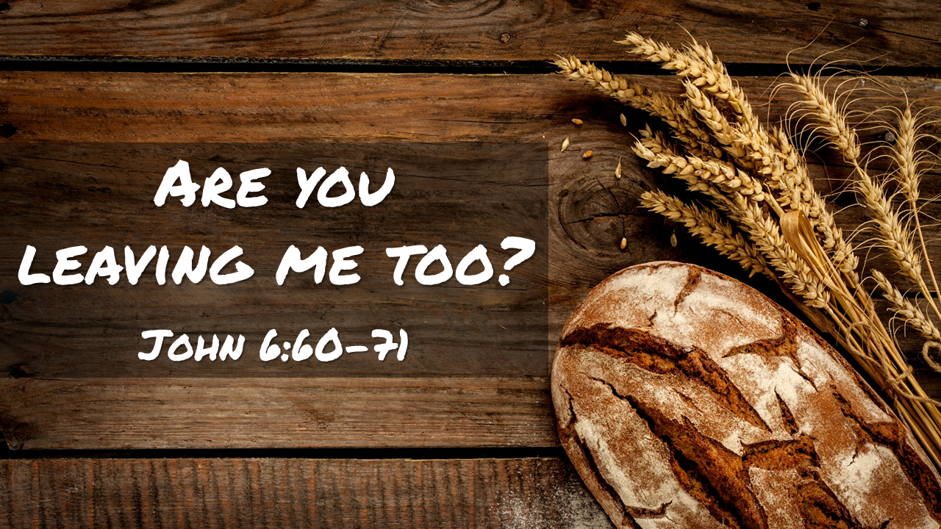
Jimmy Yen – 23/05/2021

Slide 2
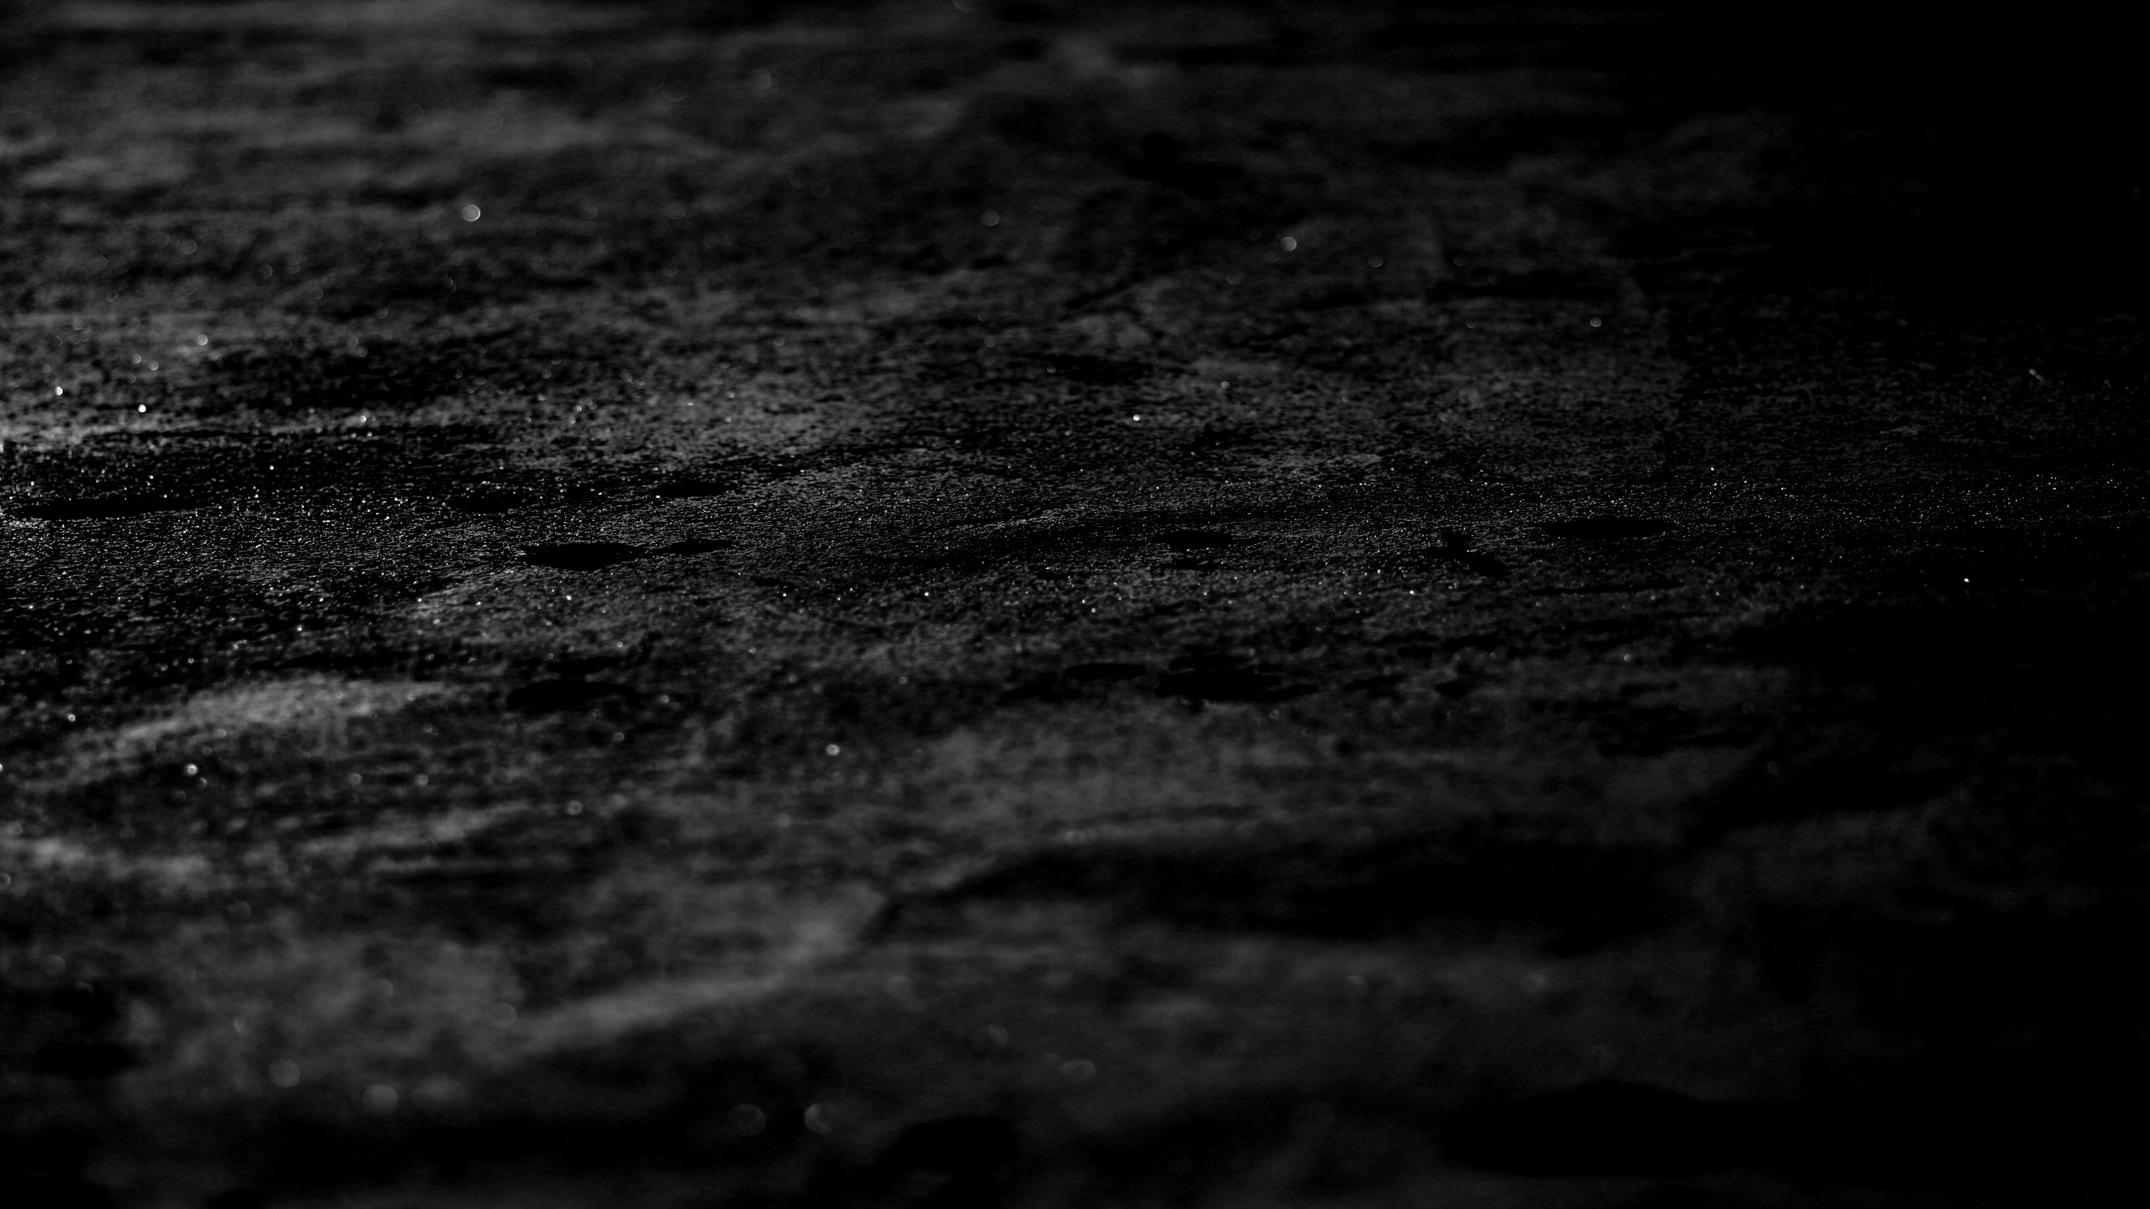
John 6:60-71
64 Yet there are some of you who do not believe.” For Jesus had known from the beginning which of them did not believe and who would betray him. 65 He went on to say, “This is why I told you that no one can come to me unless the Father has enabled them.” 66 From this time many of his disciples turned back and no longer followed him. 67 “You do not want to leave too, do you?” Jesus asked the Twelve.
New International Version

Slide 3
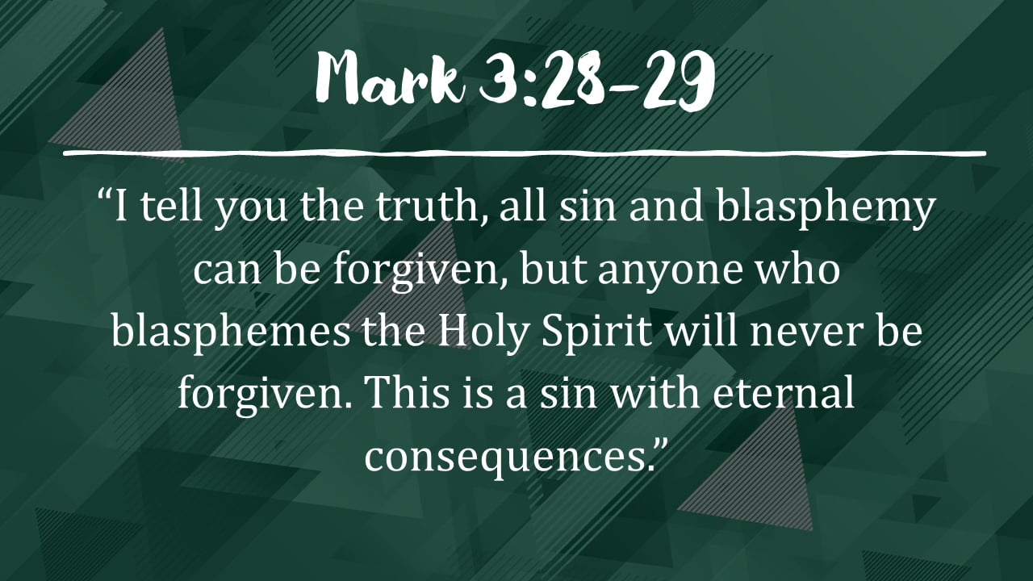

Slide 4
Results of not believing in Jesus …
No other sacrifice for sins
No provision for salvation
No other name to be saved
No other way, truth and life
Can’t satisfy God’s wrath
Insulting to the Spirit of Grace

Slide 5
Syndromes of False Disciples…
Attracted to the crowd
Fascinated by the supernatural
Think only of earthly benefits
No desire for true worship
Seek only personal fulfilment
See God as servant
No satisfaction in Jesus

Slide 6
John 6:53-54
53 Jesus said to them, “Very truly I tell you, unless you eat the flesh of the Son of Man and drink his blood, you have no life in you. 54 Whoever eats my flesh and drinks my blood has eternal life, and I will raise them up at the last day.
New International Version

Slide 7
Syndromes of False Disciples…
Accept Jesus’ works
Reject Jesus’ words

Slide 8
John 6:60-71
60 On hearing it, many of his disciples said, “This is a hard teaching. Who can accept it?” 61 Aware that his disciples were grumbling about this, Jesus said to them, “Does this offend you? 62 Then what if you see the Son of Man ascend to where he was before! 63 The Spirit gives life; the flesh counts for nothing. The words I have spoken to you - they are full of the Spirit and life.
New International Version

Slide 9
John 6:60-71
60 On hearing it, many of his disciples said, “This is a hard teaching. Who can accept it?” 61 Aware that his disciples were grumbling about this, Jesus said to them, “Does this offend you? 62 Then what if you see the Son of Man ascend to where he was before! 63 The Spirit gives life; the flesh counts for nothing. The words I have spoken to you - they are full of the Spirit and life.
New International Version

Slide 10
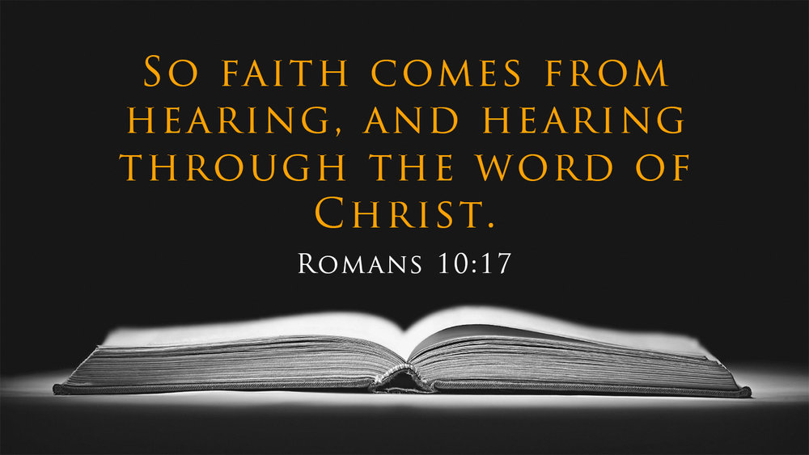

Slide 11
John 6:60-71
64 Yet there are some of you who do not believe.” For Jesus had known from the beginning which of them did not believe and who would betray him. 65 He went on to say, “This is why I told you that no one can come to me unless the Father has enabled them.” 66 From this time many of his disciples turned back and no longer followed him. 67 “You do not want to leave too, do you?” Jesus asked the Twelve.
New International Version

Slide 12
John 6:60-71
64 Yet there are some of you who do not believe.” For Jesus had known from the beginning which of them did not believe and who would betray him. 65 He went on to say, “This is why I told you that no one can come to me unless the Father has enabled them.” 66 From this time many of his disciples turned back and no longer followed him. 67 “You do not want to leave too, do you?” Jesus asked the Twelve.
New International Version

Slide 13
John 6:60-71
68 Simon Peter answered him, “Lord, to whom shall we go? You have the words of eternal life. 69 We have come to believe and to know that you are the Holy One of God.” 70 Then Jesus replied, “Have I not chosen you, the Twelve? Yet one of you is a devil!” 71 (He meant Judas, the son of Simon Iscariot, who, though one of the Twelve, was later to betray him.)
New International Version

Slide 14

Have I not chosen you?
Do you want to leave Me too?

