Slide 1
Isaiah 9: 6-7
6 For to us a child is born, to us a son is given, and the government will be on his shoulders. And he will be called Wonderful Counselor, Mighty God, Everlasting Father, Prince of Peace.
7 Of the increase of his government and peace there will be no end. He will reign on David's throne and over his kingdom, establishing and upholding it with justice and righteousness from that time on and forever. The zeal of the Lord Almighty will accomplish this.

Slide 2
A PRECIOUS
TRUST
Denise Hyland
28/11/21

Slide 3
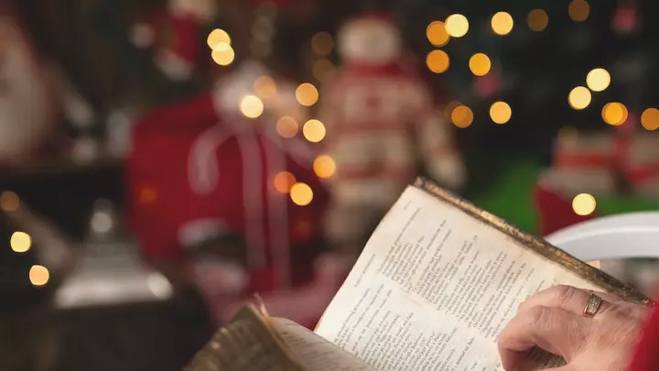
ISAIAH 9:6,7
For to us a child is born,
to us a son is given, and the government will be on his shoulders. And he will be called
Wonderful Counselor, Mighty God,
Everlasting Father, Prince of Peace. Of the greatness of his government and peace there will be no end. He will reign on David’s throne
and over his kingdom, establishing and upholding it with
justice and righteousness from that time on and forever. The zeal of the Lord Almighty will accomplish this.

Slide 4
You will conceive and give birth to a son,
and you are to call him Jesus.
He will be great
and will be called the Son of the Most High.
The Lord God will give him
the throne of his father David, and
he will reign over Jacob’s descendants forever;
his kingdom will never end.”
Luke 1:31-33

Slide 5
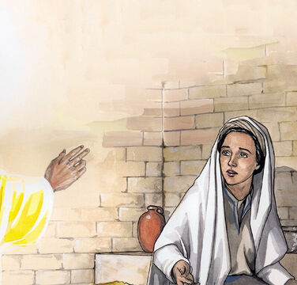
“The Holy Spirit will come on you,
and the power of the Most High,
will overshadow you.
So, the holy one to be born will be called
the Son of God. Luke 1:35

Slide 6
“I am the Lord’s servant
May your word to me be fulfilled.”
Luke 1:38

Slide 7
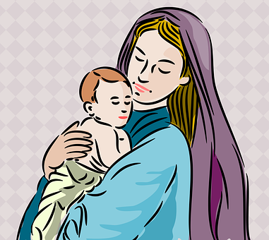

Slide 8
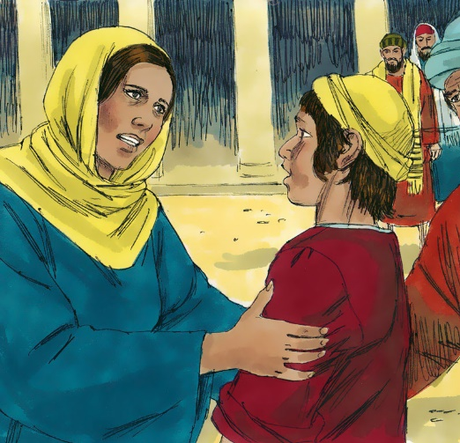
Why did you need to search for me?
Didn’t you know
that I must be
in my Father’s house?
Luke 2:49

Slide 9
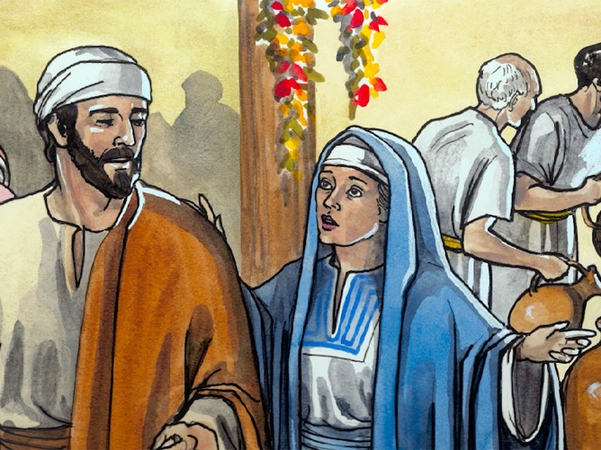
“They have
no more wine”
John 2:4

Slide 10
“They have
no more wine”
“Woman, why do you involve me,
My hour has not yet come.”
John 2:4

Slide 11
Mark 3:35
Whoever does
God’s will
is my brother
and sister
and mother.

Slide 12
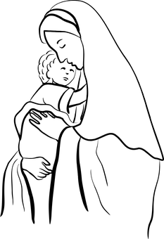

Slide 13
JESUS
is the Precious Trust
Given for all!

Slide 14
Galatians 4:4-6 (NLT)
.. when the right time came,
God sent his Son,
born of a woman …
God sent him to buy freedom for us
… so that he could adopt us
as his very own children.
And because we are his children,
God has sent the Spirit of his Son
into our hearts,
prompting us to call out,
“Abba, Father.”

Slide 15
Hebrews 2:14-17
Since the children have
flesh and blood,
[Jesus] too shared in their humanity
so that by his death
he might break the power of … the devil
and free those who all their lives
were held in slavery
by their fear of death.
[Jesus] had to be made like them,
fully human …
in order that he might become a
merciful and faithful high priest in
service to God,
that he might make atonement
for the sins of the people.

Slide 16
Colossians 1:27
… Christ in you,
the hope of glory.

Slide 17
Jesus alone is our
“great high priest
who has ascended into heaven”
It is only through Him that we can
“approach God’s throne of grace
with confidence,
so that we may receive mercy and find grace to help us in our time of need.” (Hebrews 4:14-16)

Slide 18
Submitted to God’s will – in spite of potential cost to her reputation and happiness
Realised she was not “the main attraction” even at the birth of her Son!
Did not insist on asserting her motherly authority
Accepted her Son’s correction and distance with humility
Experienced His love and care in a personal and individual way
Took her place amongst the other believers in prayer and worship

Slide 19
Am I more concerned about being the centre of attention, than I am about pointing others Jesus?
Am I submitted to God’s will – or have I been resisting His will for me?
Do I accept the correction of God and others graciously and humbly or do I proudly seek to justify myself and insist on my own way
Do I need to remember that Jesus loves me and has not forgotten me, in spite of my sin or the difficulty of my circumstances?
Do I remember with gratitude the times when God has shown me His love and care in personal and unique ways?

Slide 20
JESUS
The Precious Trust
given for us all

