Slide 1
Bible Reading
Warwick McKenzie

Slide 2
Luke 19:1-10
1 Jesus entered Jericho and was passing through. 2 A man was there by the name of Zacchaeus; he was a chief tax collector and was wealthy. 3 He wanted to see who Jesus was, but because he was short he could not see over the crowd. 4 So he ran ahead and climbed a sycamore-fig tree to see him, since Jesus was coming that way.
New International Version

Slide 3
Luke 19:1-10
5 When Jesus reached the spot, he looked up and said to him, “Zacchaeus, come down immediately. I must stay at your house today.” 6 So he came down at once and welcomed him gladly. 7 All the people saw this and began to mutter, “He has gone to be the guest of a sinner.”
New International Version

Slide 4
Luke 19:1-10
8 But Zacchaeus stood up and said to the Lord, “Look, Lord! Here and now I give half of my possessions to the poor, and if I have cheated anybody out of anything, I will pay back four times the amount.” 9 Jesus said to him, “Today salvation has come to this house, because this man, too, is a son of Abraham. 10 For the Son of Man came to seek and to save the lost.”
New International Version

Slide 5
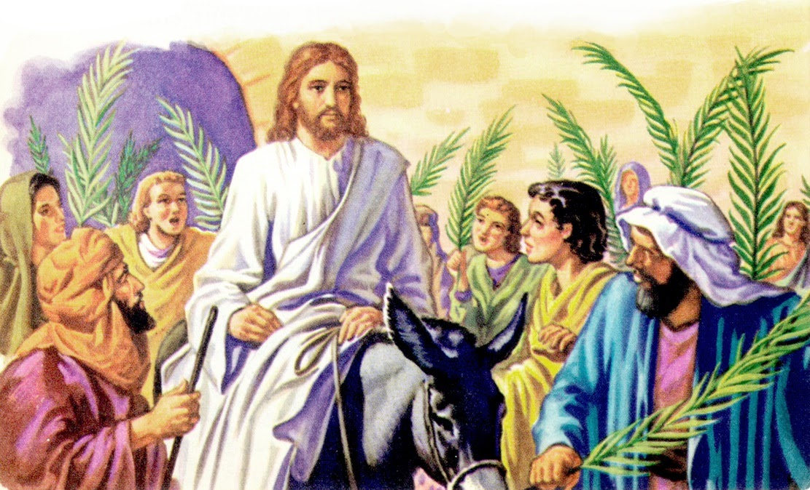

Slide 7
Zacchaeus
Chief Tax Collector
Luke 19:2

Slide 8
Zacchaeus
Chief Tax Collector
Wealthy
Luke 19:2

Slide 9
Zacchaeus
Chief Tax Collector
Wealthy
Short in height
Luke 19:3

Slide 10
Zacchaeus
Chief Tax Collector
Wealthy
Short in height
Sinner
Luke 19:7,9

Slide 11
Jesus
Planned route
Luke 19:1, 5

Slide 12
Jesus
Planned route
Looked up
Luke 19:5

Slide 13
Jesus
Planned route
Looked up
Called out using first name
Luke 19:5

Slide 14
Jesus
Planned route
Looked up
Called out using first name
Spends time
Luke 19:5-6

Slide 15
Jesus
Planned route
Looked up
Called out using first name
Spends time
Acknowledges Zacchaeus’ spiritual status
Luke 19:9

Slide 16
Zacchaeus
Chief Tax Collector
Wealthy
Short in height
Sinner
Forgiven and generous
Luke 19:8

Slide 17
People watching on
Made moral call
Saw a changed life
Heard the words of Jesus
Luke 19:3,7,8

Slide 18
Look out for people in trees

Slide 20
Luke 19:10
Are you lost?
Who are we praying for?
Who are we pointing to Jesus?

