Slide 1
Luke 1: 5-25; 76-80
76And you, my child, will be called a prophet of the Most High; for you will go on before the Lord to prepare the way for him, 77to give his people the knowledge of salvation through the forgiveness of their sins, 78because of the tender mercy of our God, by which the rising sun will come to us from heaven 79to shine on those living in darkness and in the shadow of death, to guide our feet into the path of peace." 80And the child grew and became strong in spirit; and he lived in the desert until he appeared publicly to Israel.

Slide 2
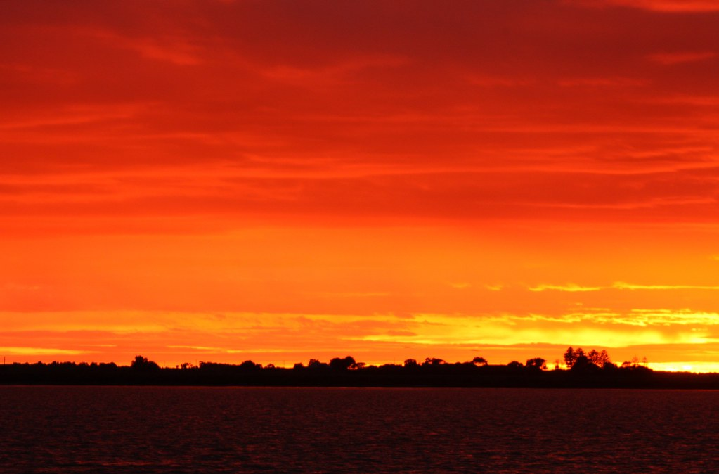
Zechariah Greg Mellow 21/11/2021
Priest, Righteous Man, Cynic, Prophet

Slide 3
Righteous (Elizabeth too)
Priest, on duty
*Offering Incense - big day!
Zechariah

Slide 4
Angel appears
Gosh (fear reaction)
‘Prayers answered”
Special baby coming
Spirit empowered -> revival coming
Zechariah

Slide 5
Z: (rubbish), Prove it, Impossible!
G: (i) don’t shoot the messenger
(ii) is it good news, don’t complain
(iii) as you wish
Z: (oops) E: Yay!
Zechariah

Slide 6
Philosophy, Theology <------> Faith
understanding and managing life
Disciples, learners & followers
“Jesus grew in wisdom and stature”
Luke 2:52
Knowing stuff

Slide 7
Abraham believed God → righteous
Angel: you will have a son
Sarah: (laughs)
Jacob: wrestles with God
Responding to God

Slide 8
Luke 1:4, v18 ‘so you may know’
Start: Jerusalem Temple, Offering, *God’s Good News, People: Prove it
End: … same
Jerusalem to the world
Literary Context

Slide 9
1:67-78
The Lord is coming to Israel
Salvation for Israel, forgiveness
A strong king
A safe nation
A righteous people
Life Context

Slide 10
1:76-79
The Lord is coming to individuals
Salvation, Forgiveness
God’s tender mercy
→ Jesus, A Giver of Hope
Life Context

Slide 11
flawed → Helped & Accepted
hopelessness,
angst,
threat of death → Revived Hope
strife & turmoil → Peace
Life Context

Slide 12
Christmas as Sunrise
Renewed Hope through Jesus Christ

