Slide 1
Acts 6:1-6
1 In those days when the number of disciples was increasing, the Grecian Jews among them complained against the Hebraic Jews because their widows were being overlooked in the daily distribution of food. 2 So the Twelve gathered all the disciples together and said, "It would not be right for us to neglect the ministry of the word of God in order to wait on tables. 3 Brothers, choose seven men from among you who are known to be full of the Spirit and wisdom. We will turn this responsibility over to them 4 and will give our attention to prayer and the ministry of the word."

Slide 2
Acts 6:1-6
5 This proposal pleased the whole group. They chose Stephen, a man full of faith and of the Holy Spirit; also Philip, Procorus, Nicanor, Timon, Parmenas, and Nicolas from Antioch, a convert to Judaism. 6 They presented these men to the apostles, who prayed and laid their hands on them.

Slide 3
Acts 7:55-60
55But Stephen, full of the Holy Spirit, looked up to heaven and saw the glory of God, and Jesus standing at the right hand of God. 56"Look," he said, "I see heaven open and the Son of Man standing at the right hand of God." 57At this they covered their ears and, yelling at the top of their voices, they all rushed at him, 58dragged him out of the city and began to stone him. Meanwhile, the witnesses laid their clothes at the feet of a young man named Saul. 59While they were stoning him, Stephen prayed, "Lord Jesus, receive my spirit." 60Then he fell on his knees and cried out, "Lord, do not hold this sin against them." When he had said this, he fell asleep.

Slide 4
Life in the Early Church
Challenges and Consequences
Ian Graham – Stephen
Notes:
This is the third in our current series of 4 Sundays about Life in the Early Church.

Slide 5
Life in the Early Church Challenges and Consequences
Past couple of weeks:
Introduction to Acts of the Apostles
Acts of the Holy Spirit
Peter & John
Transition from OT to Church
Invitation to join is still open to all
Notes:
In the past 2 weeks we have had –
Overview of the Acts of the Apostles – Kay suggested that it would be more appropriately titled ‘Acts of the Holy Spirit’
Holy Spirit is mentioned over 50 times and in every chapter
Witness/testify/tell used more than 30 times
Last week – Peter & John; Woody spoke about the transition from OT to Church (fulfilment of prophecies); all people on earth being blessed by Abrahams descendants - the gospel share with all nations and invitation is still open to follow Jesus – join his plan for humanity.

Slide 6
Accept Jesus’ invitation to be a part of the blessing to the nations
Seek the Holy Spirit’s empowering for direction in our lives
Expect opposition to God’s plan and our work for Him
See God work in us and through us
Notes:
Here are the challenges left with us last week:
Accepts Jesus’ invitation to be a part of the blessing to the nations
Seek the Holy Spirits empowering for direction in our daily lives
Expect opposition to God’s plan and our work for Him
See God work in us and through us.

Slide 7
Context: Early Church
Acts 1 – Ascension of Jesus
Acts 2 - Day of Pentecost – Holy Spirit comes filling the Jewish Christians;
Peter preaches and 3000 added to the church;
Church community formed and converted people added to it daily
Acts 3 – Peter heals lame man and preaches in the temple
Acts 4 –Peter and John before council – and threatened by council;
Church has grown to 5000 men; the believers pray for courage
Acts 5 – Ananias & Sapphira’s dishonesty punished;
Apostles heal many and also flogged by religious leaders
Acts 6 – Seven men chosen to serve the church in a practical way;
Stephen is one of these men
~31-35AD
Notes:
Today we are focussing on Acts chapters 6 and 7 which related the events around Stephen.
Briefly for context what has happened in the book of Acts to this point.
The events in Ch 6 & 7 seems to have occurred sometime between 31 to 35AD; 2-6 years after Jesus’ ascension.
In Ch 6 we see the first mention of Stephen. The church has growth to such a size that the Apostles saw a need to appoint some men to look after some of the practical needs of the church so that they could be freed up to focus on prayer and teaching. Especially since there were complaint that certain widows were being overlooked in the daily food distribution
So they pray and appoint 7 men who meet the criteria of being ‘full of the spirit and wisdom’.
Stephen is the first of the 7 mentioned.

Slide 8
Stephen – who was he?
Selected as a ‘deacon’/leader
“A man full of faith and of the Holy Spirit” (6:5)
“Full of God’s grace and power, did great wonders and miraculous signs among the people” (6:8)
Nothing else record about him - Age/Family/Marital Status/Profession/…?
Notes:
So what do we know about Stephen.
He was appointed in this practical leadership role – today it would be one of the board members or what we called a deacon in the past.
He was a man ‘full of faith and of the Holy Spirit’ – he is only one of the 7 that get a special mention but that might be because the author is about to tell us more about Stephen.
In V8 is mentions that he was ‘Full of God’s grace and power, did great wonders and miraculous signs among the people’. Clearly the Apostles were not the only one that God used to demonstrated his power through miracles.
Other than these couple of points we know very little about Stephen.
How old was he? Probable middle aged or senior given his understanding of the scriptures.
Did he have a family?
What was his occupation?
When was he converted? Probably would have seen or hear about Jesus when he was alive and possibly converted on the day of Pentecost or thereafter.
We don’t know the answers to these question and it must not be that important since it has been left out of the story by the author who was inspired by the Holy Spirit.

Slide 9
Challenge:
Are you and I full of the Holy Spirit and is that evident to those around us?
Notes:
The main thing that we know about Stephen that he was full of the Holy Spirit and that was evident to those around him.
How do we stand up in this respect – is it evident to those around you and I that we are full of the Holy Spirit?
I remember meeting a new starter at the job I had about 20 years ago. From the outset it was evident that he was different and I assumed immediately that he was a Christian. He was happy and joyful, outwardly kind and considered going out of his was to help people wherever he could. I did speak to him and find out that he was a Christian. He left after about a year and went to the middle east to share his faith with local in the country that he went to. He sent back some interesting stories. My point here was that it was obvious that he was a Christian. That is not to say that there are plenty of non-Christian people around that have happy and joyful demeanours.
Stephen was full of the Holy Spirit.
Later in the story we see that his face has the appearance of an angel. In that respect we are reminded of Moses after he had spent some time with God on Mt Sinai – he had to cover his face. Also the disciples who were with Jesus on the mount transfiguration. The more time we spend with God the more his Holy Spirit will impact on our lives such that we will stand out.

Slide 10
Events of Acts 6 & 7:
Members of the Synagogue of the Freedmen argue with Stephen but “could not stand up against his wisdom or the Spirit by whom he spoke” (6:11)
He is falsely accused of blasphemy against Moses and against God and later for speaking against the temple (“holy place”) and against the law. (6:13) and is taken before the Sanhedrin (highest court of justice and the supreme council)
They saw that his face was like the face of an angel (6:15)
He is given the opportunity to respond to the false accusations
Notes:
Shortly after we read that Stephen is more than a match when arguing with the some of the spiritual leaders of the community.
They become upset and falsely accuse him of ‘blasphemy against Moses and against God and for speaking against the temple and against the law’.
They seize Stephen and take him before the Sanhedrin.
It is here that we read that all who were sitting in the Sanhedrin looked intently at Stephen and they saw that his face was like the face of an angel.

Slide 11
Events of Acts 6 & 7:
Stephen responses with the longest sermon recorded in Acts
He starts with Abraham and steps through history – the patriarchs, Moses, Joshua, David, Solomon – reiterating the facts about God’s dwelling place and law.
7:48-50 "However, the Most High does not live in houses made by men. As the prophet says: " 'Heaven is my throne, and the earth is my footstool. What kind of house will you build for me? says the Lord. Or where will my resting place be? Has not my hand made all these things?'
Notes:
In response the High Priest asking if these accusations are true Stephen responds with the longest speech recorded in Acts.
His response is said to be one of the best commentaries about the events and history recorded in the old Testament. He is talking with men that knew the history and the scriptures he reminds them about how God interacted with their ancestors.
The Holy Spirit is giving him the words to say. I am pretty sure that Stephen did not have this speak prepared in his back pocket ready for this occasion.
He starts at the start of the history of the Jews – Abraham.
I will not talk about the detail in Stephen speak.
He reminds them about how God gave his law to Moses and set up the Tabernacle as His dwelling place with the Israelites. He reminds them how they disregarded his laws and worship idols made by human hands. He reminds them about how the original temple was built by Solomon.
Then he reminds them that God doesn’t live in the temple made by men. Read 7:48-50.

Slide 12
Events of Acts 6 & 7:
7:51-54 "You stiff-necked people, with uncircumcised hearts and ears! You are just like your fathers: You always resist the Holy Spirit! Was there ever a prophet your fathers did not persecute? They even killed those who predicted the coming of the Righteous One. And now you have betrayed and murdered him-- you who have received the law that was put into effect through angels but have not obeyed it."
They get upset, drag Stephen out of the city and stone him to death
Notes:
He final gets to the point of highlighting where the religious leaders have gone wrong.
7:51-54
He is talking with the men that were instrumental in the false accusation and crucifixion of Jesus.
Their response is not unexpected – they get very upset, drag Stephen out of the city and throw stones at him until he is no longer alive.
However Stephen seems almost unaware of the event occurring around him and he has a vision of Jesus sitting at God’s right hand.
He prays asking the Jesus would receive his spirit and then that the sins of the ones stoning him would not be held against them.
You will note many parallels between Stephen story and that of Jesus as he went to the cross.

Slide 13
Characteristics of Stephen:
His face was seen as the face of an angel (6:15)
The Holy Spirit gave him the words to respond with
He looks to heaven and visualises Jesus standing at the right hand of God
In his last moments he prays
‘Lord Jesus, receive my spirit’
‘Lord, do not hold this sin against them’
Notes:
Summarising aspects of Stephen during this last day of his life.

Slide 14
Acts of the Holy Spirit:
The Holy Spirit is active in Stephen’s life throughout this story
Miraculous signs
Angel face
Verbal response
Vision
Acceptance of the fatal outcome
Was it a good outcome?
Notes:
The main lesson to be learnt from Stephens story is that the Holy Spirit was active throughout these event in Stephen’s life.
Was it a good outcome?
You may say no since Stephen a valuable member of the community lost his life.
But you have to say yes because it clearly was part of God’s plan not that we know all of the details. We are told the name of one of the witnesses, Saul, and I dare say that these events had a big impact on him and are part of what lead him to eventually be converted. Many others witness this day is Stephens life.
Whilst there seems to have already been some persecution in the early church, Stephen is the first record of someone dying for their faith. After this persecution become rampant and the church started leaving Jerusalem moved out into the other areas taking the gospel message with them just as Jesus had instructed.

Slide 15
Challenge for you and me:
Mark 8:34-36 34, Then he called the crowd to him along with his disciples and said: "If anyone would come after me, he must deny himself and take up his cross and follow me. For whoever wants to save his life will lose it, but whoever loses his life for me and for the gospel will save it. What good is it for a man to gain the whole world, yet forfeit his soul?
Willing to count the cost (carry the cross) of being a Christian?
Notes:
Jesus said that if we follow him we are to deny ourselves and take up his cross.
What does it cost you and me today to follow Jesus?
Certainly will not cost us our physical life. Did you know that last year on average 13 Christians were martyred each day. We are fortunate to live in a country where we will not be persecuted to that extent.
It should cost you time - spending time with God daily; doing the good works that he has assigned for you to do rather than doing things just to please yourself.
There should be some financial cost as God direct you to give some of your money to his work.
Standing in the community – you may be ignored for a promotion because you are a Christian.
What will it cost you and me today to follow Jesus this week?

Slide 16
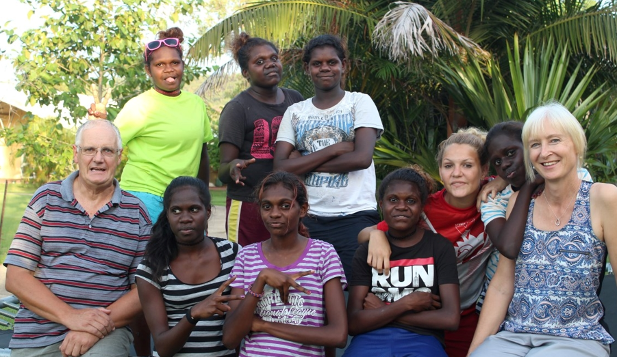
Notes:
This photograph was taken while Barbara and I were working as house parent in a Christian indigenous boarding school in 2015. These were my 8 daughters at the time.
We felt that God had lead us there.
It did cost us.
We obviously left our family in Melb to fend for themselves.
I would rather not have gone through many of the experience that we went through. Actual to many to repeat here but an example was on a fortnightly visit to Darwin we had 3 girls go their own way when we stopped for tea. We had to report this to the police and the went looking for them for an hour or 2 before finally heading home to the school. We didn’t sleep much that night – concerned for these girls who were in our car. We felt like failures. Etc. They were found the next day and eventually returned to the school.
However although there were many unpleasant experiences and duties, there were also many enjoyable experiences and God taught and grew us during this time. We also gained some good friends.

Slide 17
Challenge:
Focussed on heaven things – the end goal?
Colossians 3:1-3 Since, then, you have been raised with Christ, set your hearts on things above, where Christ is seated at the right hand of God. Set your minds on things above, not on earthly things. For you died, and your life is now hidden with Christ in God.

Slide 18
Challenge for you and me:
Empowered by the Holy Spirit?
Notes:
We spoke about this earlier. Living a life full of the Holy Spirit.
How does one go about doing this.
You could pretend that you are full of the Holy Spirit but that would be a lot of work and quite pointless.
Firstly you need to be a follower of Jesus. Having realised you have sinned and then asking and believing that his death pays the penalty for you sins before God. Giving your life to Jesus you will be given his Holy Spirit.
Then daily you have to submit to the Holy Spirit.
You may remember this pray that the Power to Change guys that were here a couple of years ago left with us. I think it is helpful to consider praying something like this at the start of every day.

Slide 19
Daily Prayer:
Lord Jesus, I choose you as the centre of my life.
Through the power of the Holy Spirit,
I want to listen to you and obey what you say;
anytime; anywhere; at any cost; whatever it is
– I am yours.
Notes:
I encourage you to write your own daily prayer and pray it every day and see what God does with your life.
Stephen was full of the Holy Spirit.
Please come and chat if you want to talk about any of these things.

