Slide 1
Mother’s Day 2023
Love is spoken here
Joy is chosen here
Grace is given here

Slide 2
Love is spoken here
^{1Corinthians 13:4-8} Love is patient, love is kind. It does not envy, it does not boast, it is not proud. It is not rude, it is not self-seeking, it is not easily angered, it keeps no record of wrongs. Love does not delight in evil but rejoices with the truth. It always protects, always trusts, always hopes, always perseveres. Love never fails.

Slide 3
Love is spoken here
Cath Jones shares her story

Slide 4
Love is spoken here
Ephesians 4:15 Speaking the truth in love we will in all things grow up into him who is the Head, that is, Christ.

Slide 5
Joy is chosen here
Carrie Baker shares her story

Slide 6
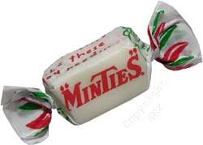
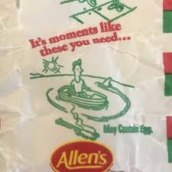
Joy is chosen here
Psalm 5:11 You have made known to me the path of life; you will fill me with joy in your presence, with eternal pleasures at your right hand.

Slide 7
Grace is given here
What is grace
Basis for the Christian faith
God’s Grace undeserved favour

Slide 8
Grace is given here
Kat Mauger shares her story

Slide 9
Grace is given here

Slide 10
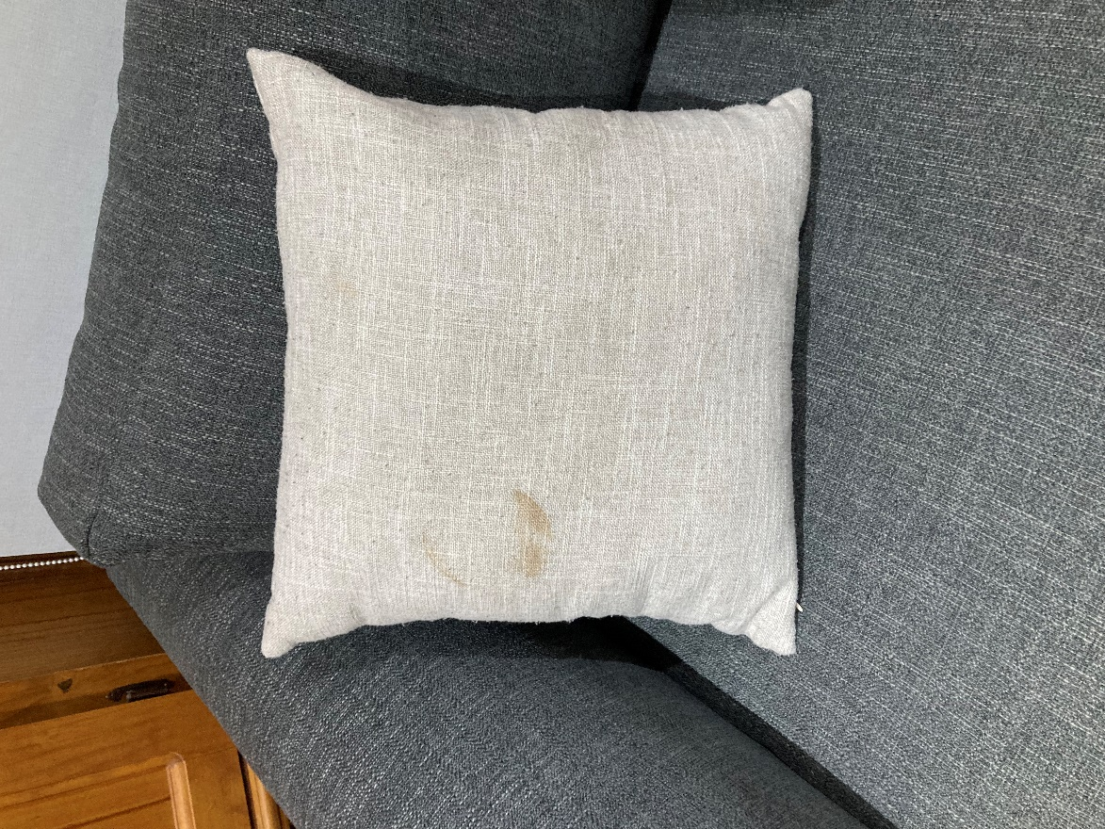
Stains and brokenness through relationships
1 John 1:9 If we confess our sins, God is faithful and just and will forgive us our sins and purify us from all unrighteousness
2 Corinthians 13:14 May the grace of the Lord Jesus Christ, and the love of God, and the fellowship of the Holy Spirit be with you all

Slide 11
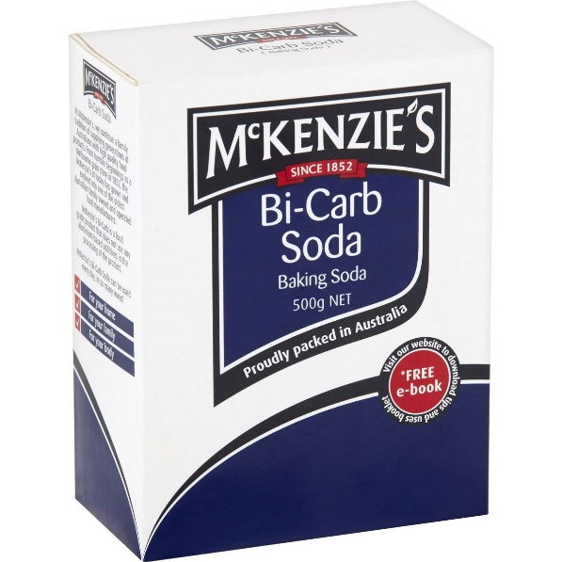
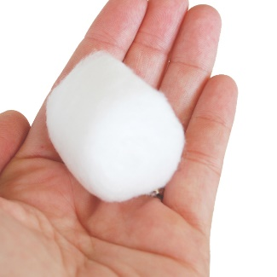
Gift Bags
Mother’s Day 2023
Love is spoken here
Joy is chosen here
Grace is given here
Love Ephesians 4:15 Speaking the truth in love we will in all things
grow up into him who is the Head, that is, Christ.
Joy Psalm 5:11 You have made known to me the path of life; you will
fill me with joy in your presence, with eternal pleasures at your right hand.
Grace 2 Corinthians 13:14 May the grace of the Lord Jesus Christ, and
the love of God, and the fellowship of the Holy Spirit be with you all

